Slide 1


Major Project I
Title:
Secure Swift Scanner
Presented by:
Aakanksha Dhyani, 500084198, BTECH-CSE-CSF-VII-B1 Aditya Agarwal, 500082673, BTECH-CSE-CSF-VII-B1
Aditya Singh Tomar, 500082918, BTECH-CSE-CSF-VII-B1
Guided by:
Dr. Akashdeep Bhardwaj

Slide 2
Content
Introduction
Problem Statement
Objectives
Tech Stack
Methodology
SWOT Analysis
Application of the Project
PERT Chart
References

Slide 3

1. INTRODUCTION
Web applications serve as the cornerstone of businesses, services, and user interactions.
Potential for cyber threats and vulnerabilities causing compromise of confidentiality, integrity, and availability of these applications.
Manual assessment of web applications for vulnerabilities is time-consuming and often ineffective.
Secure Swift Scanner is a dynamic web application vulnerability scanner that offers a systematic approach to detecting vulnerabilities by automatically assessing web applications for potential weaknesses.
The primary objective of our tool is to focus on remediation rather than manual inspection.
It also generates detailed reports, providing a clear overview of identified vulnerabilities and potential risks.

Slide 4


2. Problem Statement
Web applications have become indispensable for business processes
Exposed applications to a multitude of cyber threats, like CORS, LFI, Open Redirect, Brute force and many more.
Current security measures often fall short in providing comprehensive protection.

Slide 5

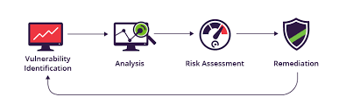
3. Objectives
Some of our key objectives are as follows:
Develop a comprehensive security assessment tool.
Detect a wide range of vulnerabilities (Approx. 50+)
Generate detailed and actionable security report.
Commit to continuous improvement and updates to address emerging threats.
Provide remediation guidance for identified vulnerabilities.

Slide 6
4. Technology Stack
Development:
Python Version: 3.11.1
Software specifications:
Visual Studio Code
pycharm.
Hardware Interface:
Server Side:
Operating System: Windows, Mac and Linux.
RAM: 2 GB or more.
Processor: i3 or above.
Display: 1024x768 or above.
Platform Used: VS Code.
Hard Drive: minimum 4GB.
IDE: VS Code.
Client Side:
Operating System: Windows, Mac and Linux.
RAM: 2 GB or more.
Processor: i3 or above.
Display: 1024x768 or above.

Slide 7

5. Methodology
Libraries:
Argparse: Used for parsing command-line arguments and options.
Subprocess: Running shell commands and interacting with the system's shell.
OS: For various operating system-dependent tasks
Time: For managing time-related tasks
Threading: For creating and managing threads
Data Structure:
Lists: For storing intervals for time conversion, specifying processes for different severity levels, and defining skip options for scans.
Dictionaries: Used to store key-value pairs, color coding text output.
Tuples: Used for creating pairs of data, to define time intervals, map vulnerability severity levels to their corresponding descriptions.
Classes: Used as a data structure to encapsulate related data and functions.
Strings: Used to store textual data, including error messages, informational text.

Slide 8
6. SWOT Analysis
S
W
Weaknesses
Strengths
Comprehensive Vulnerability Detection
Automated Scanning Techniques
Comprehensive Database
Scalability
Skill and Knowledge Requirements
SWOT
Opportunities
Threats
Rapidly Changing Threat Landscape
User Adoption and Awareness
Rising Cybersecurity Concerns
Collaboration and Contributions
O
T
Fig.1 SWOT Analysis

Slide 9
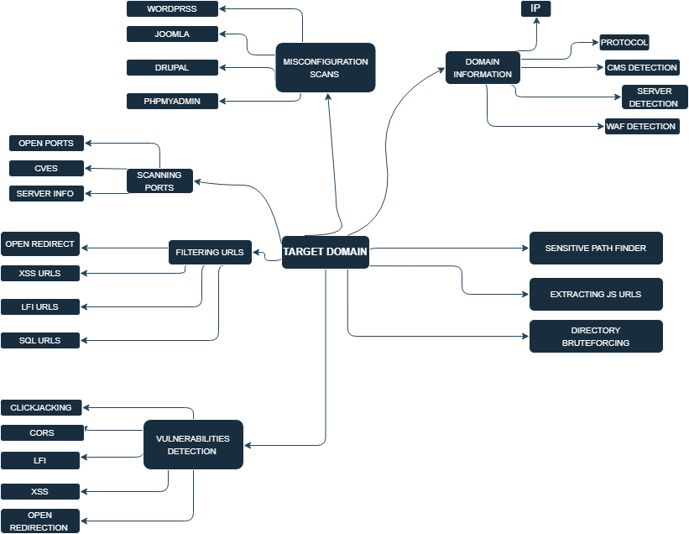
7. Application of the Project
Fig.2: Flow Chart

Slide 10
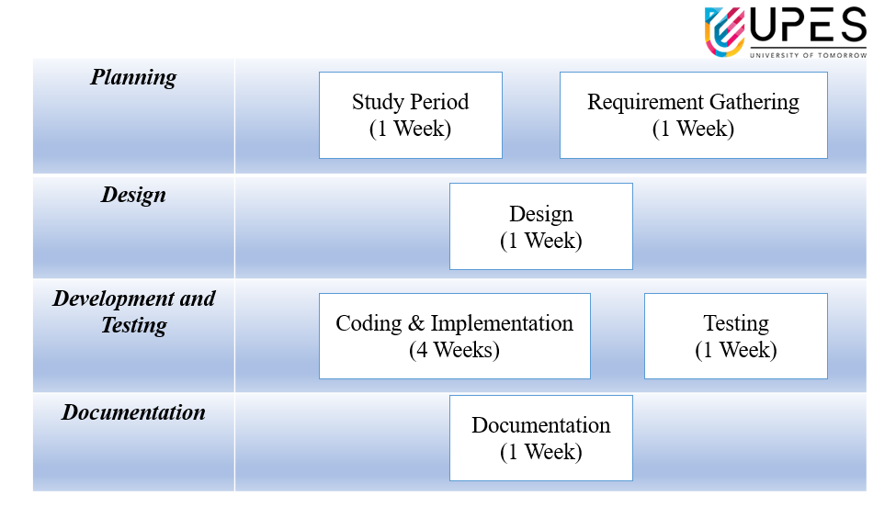
8. PERT Chart
Fig.3 Program Evaluation and Review Technique Chart

Slide 11
9. Bibliography
Payload Command Injection
https://github.com/xsuperbug/payloads/blob/master/XSS%20-2
Payload SQL Injection
https://github.com/payloadbox/sql-injection-payload-list
Xsuperbugs
https://github.com/xsuperbug/payloads/blob/master/XSS%20-2

Slide 12

Thank You

